Slide 1
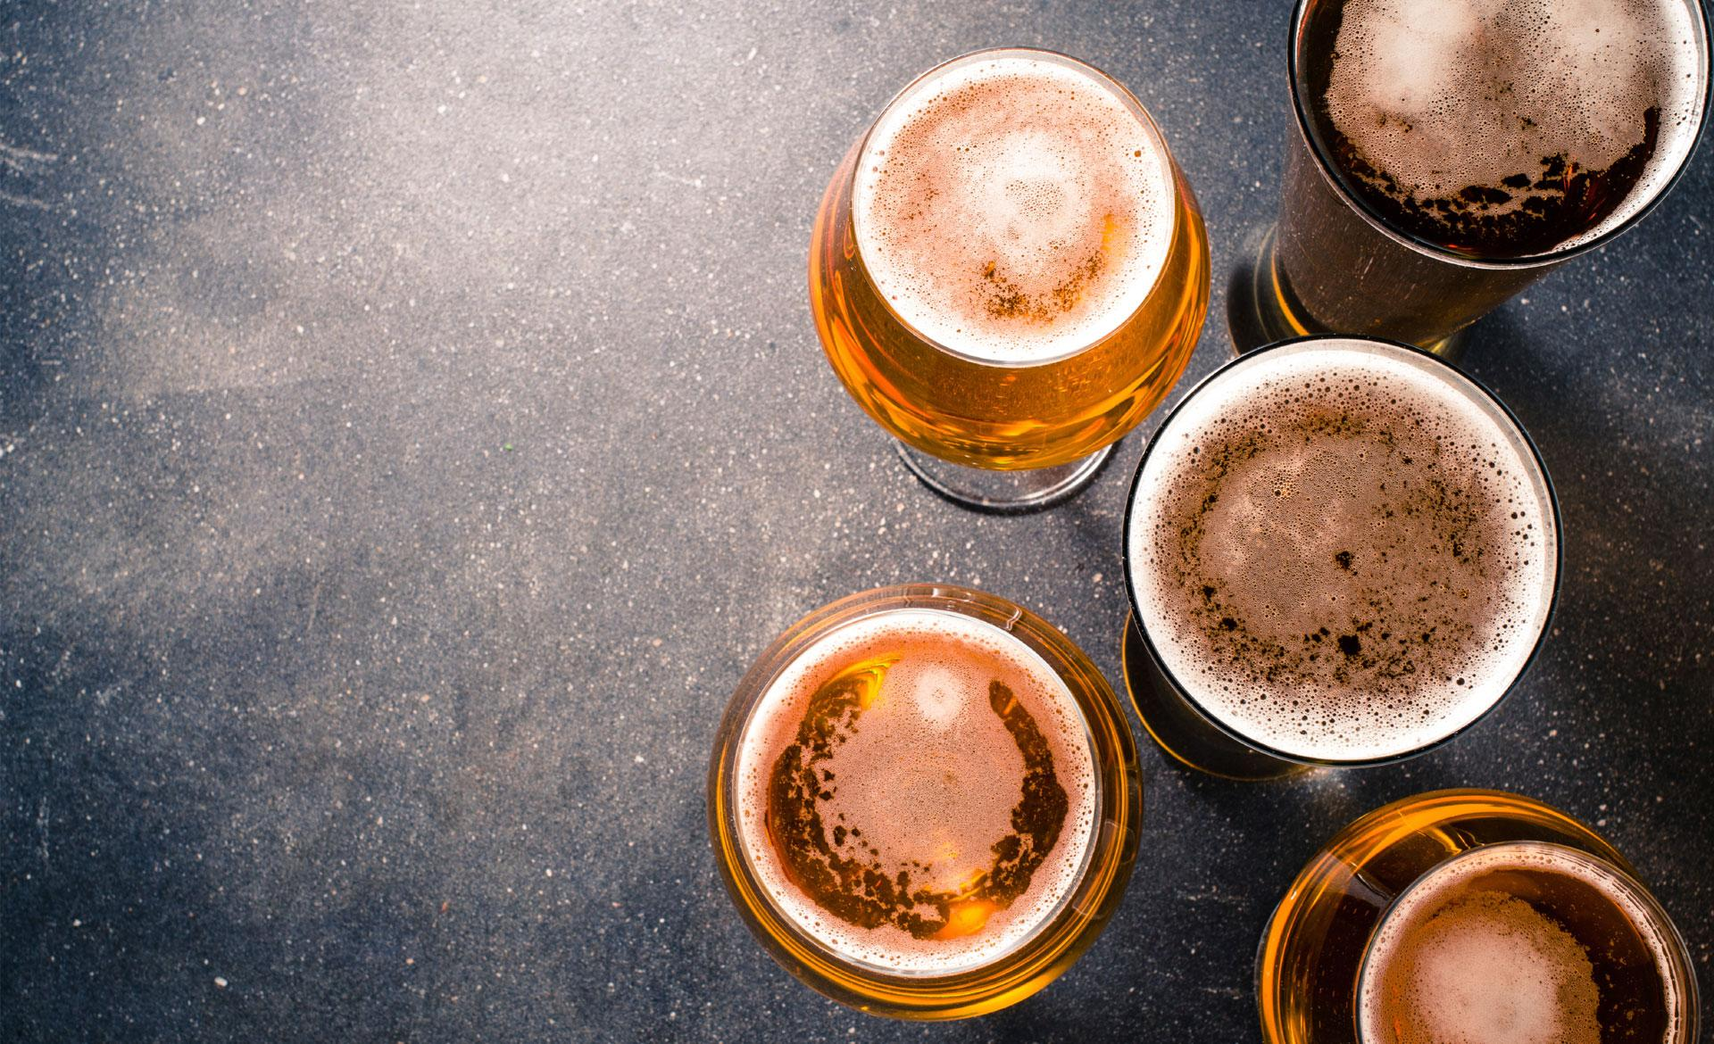
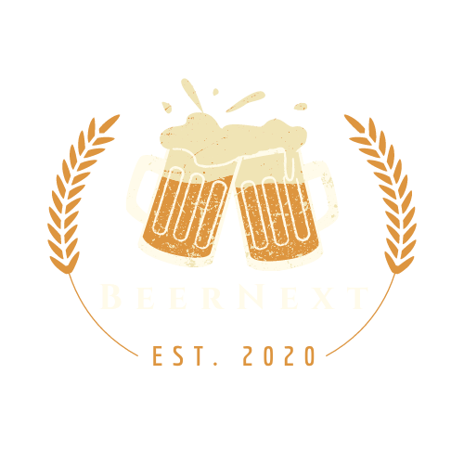
Predictive Pandas presents
Michelle Hocking
Eamonn McCallum
Pooja Mallard
Ruohong Yuan
Yann Chye
Kat Shamai

Slide 2


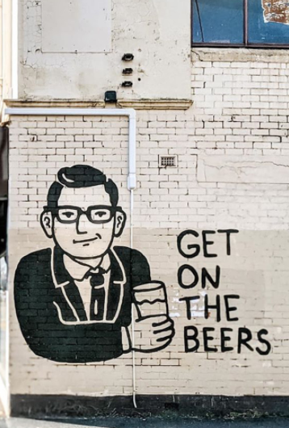



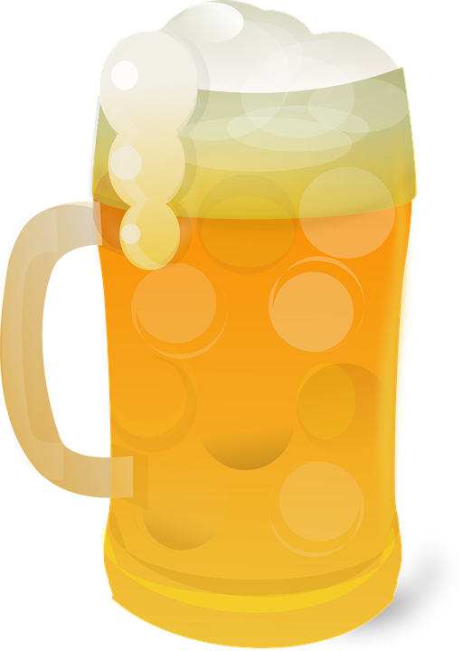

Now that Victorians can “get on the beers” again, what to drink?
You can go with the same old, same old but you’re probably tired of that since that’s probably all you’ve been drinking for the past 6 months
We thought it would be great to celebrate the world of craft beers and get beer lovers to try something different, and find a new favorite
Using review data and data on breweries, we set out on a virtual brewery data crawl to find good datasets, and ways to teach a model how to appreciate craft beer, and recommend a good one
The oldest brewery dates back to 1040

Slide 3




Data points
From our search, we identified 3 data points which provided us with the information needed
Data point 1 – Dataworld
Data point 2 – BeerAdvocate Website
Data point 3 – Google API
The color of your beer has nothing to do with its alcohol content

Slide 4
Data Munging
Data extraction
Data transformation
Exploratory analysis
Visualising the data
Data aggregation
Adding features
Machine learning
Training the model
Web app
The Czech Republic consumed 2,033 million liters of beer in 2018

Slide 5
Data Extraction
The Pilsner’s name came from the Czech city of Pilsen (Plzeň)
13 data fields
DataWorld dataset
1.5m reviews
2 identifiers each with a descriptor
5 review scores for different features
1 timestamp
5,000 breweries
1 user profile name
16,000 unique beers

Slide 6

Data Transformation
Initial inspection and basic statistical analysis
Validate outliers (high alcohol content beers)
Clean dataset?
Data Profiling
Reduce the number of beer styles (add a feature)
Do we need more features?
Investigate the high correlation of review score categories
Inspect reviewer
score distribution and frequency
Aggregation:
Group by unique beer
Average review scores
Drop poorly rated beers i.e. >3
The four main ingredients of beer are grain, hops, yeast, and water
Notes:
** Dataset relatively ‘clean’ so focus shifted quickly to data profiling
** Validated high alcohol content beers which appeared to be outliers initially
** looked to reduce the number of beer styles from 104 to 8
** Investigated high correlation in 5 review scores and discovered dataset skewed to the right - showing tendency to rate between 3-5
** Looked for bias in profilenames
** Finally aggregated each unique beer, using an average of all its reviews
** As we were working through this we also began to look for additional features to add in

Slide 7
Adding Features
Remove retired beers
Scrape for availability
(1 feature)
Scrape for descriptive words
(173 features)
Scrape for brewery locations
(3 features)
Remove breweries with no location
Dataset
13.2k
records
Remove closed breweries
Consideration of Heroku constraints
Reduce dataset?
Use of a database?
Load static
csv file
Other ingredients are called adjuncts
Notes:
** scraped for availability of the beer eg year-round/seasonal/retired
** scraped review words (sentiment analysis) – using “start words” rather than using stop words (used 173 in total) from beer sommelier tasting guides
** scraped for brewery addresss, country, lat and lon
** the we filtered - removing retired beers, closed breweries and any brewery we couldn’t locate
** consideration given to Heroke restraints - 10’000 records and we had 13.2k records
** looked at increasing cutoff of reviews, randomising the dataframe and then reducing to 10’000, creating a database or loading a csv directly onto the server
** elected to a csv file static loaded directly on Heroku

Slide 8
Machine Learning
We wanted our model to have the ability to recommend beers outside of rigid styles like “Ale” or “Stout” but aligned to your taste preferences
To answer this, we used K-means Clustering to generate discrete groups to enrich our dataset independent of beer style
Our model optimised at 22 clusters, confirmed with a Silhouette Score of 0.61
With our new information fed back into our data we apply a cosine similarity analysis based on user input to predict five different beers
Frosty glasses cause foaming
Notes:
** initial regression analysis
** PCA analysis which wasn’t ‘fit for purpose’ but tried!
** natural ‘fit’ was K Means or neural network
** understanding limitation of KMeans ie arbitrary selection of cluster number looked at silhouette analysis

Slide 9
Training the model
2 data input approaches were tested
No. of reviews
Scores
Limited features broken up in types
All features converted into dense vector
Limited features converted into sparse vector
Limited features was selected based on arbitrary no. of clusters and comparison of Silhouette score
Flavor
Origin
Arbitrary no. of clusters were used, and combinations of features were compared using Silhouette score
Final combination of features compared by cosine similarity
No. of reviews
Score
Type
Flavor
Origin
Type
Excluded from kMeans model
Flavor
Origin
Storing any kind of beer above 12° C will deteriorate its flavor and quality
Notes:
- To create a new feature our considerations for Model were to provide a meaning number of clusters/groups and be discrete but not excessive number of clusters. **** need help on wording ***
- Two data input approaches were tested.
- All features converted into dense vector
- Limited features converted into sparse vector
We selected limited features based arbitrary number of clusters and the comparison of the silhouette score returned
- Limited features were broken up in types:
- Quantity - Total reviews, Overall scores
- Scored/Rating - Favor, quality scores
- Type - Beer styles type
- Flavor - Flavor description words
- Origin - Country of production
Arbitrary number of clusters was used and combinations of features were compared by silhouette score. Final combination of features was quality, score and type and the flavor and origin features would be directly compared by cosine similarity
- Cluster optimization was don using range of clusters between 15 and 30. We validated results with elbow method of both distortions and inertia, as well as silhouette. Final decision was 22 clusters that yielded silhouette score of 0.61 with optimum distortion and inertia scores. We note there was a negative correlation in elbow scores as numbers of clusters increased so we didn’t investigate any number of clusters above our tested range. Also the distribution of clusters was not consistent it is our assumption that is due to the nature of our dataset.

Slide 10
Cluster Optimisation
Cluster optimisation was done using range of clusters between 15 and 30.
We validated results with elbow method of both distortions and inertia, as well as Silhouette.
Final decision was 22 clusters that yielded Silhouette score of 0.61 with optimum distortion and inertia scores.
We note there was a negative correlation in elbow scores as numbers of clusters increased, so we didn’t investigate any number of clusters above our tested range.
We also note the distribution of clusters was not consistent. It is our assumption that is due to the nature of our dataset.
Craft beer is more prized than commercial beer

Slide 11
Web App
Design
Sketch of what the web app could look like
Design of look and feel using d3, Javascript, and HTML
Creation of BeerNext logo
Deployment to Heroku
Customization for recommendations
A key feature of the web app is the ability to customize recommendation features
Use of sliders
Use of autocomplete for free text fields to limit variability of user input
Recommendations
Recommendations from machine learning model retrieved from Flask
Leaflet map visualization is populated with brewery information
Recommendations provided to users
Hops are poisonous to dogs.

Slide 12
Leaflet Visualisation
Idea
We wanted to add a map feature for users who want to visit the brewery or purchase the beers recommended
Visualisation
To create the map visualisation, we used Leaflet and the Google Map latitude and longitude data for each brewery
Plotting
A marker was created for each brewery (with a little beer stein of course!)
Information
Information popup boxes were created to show users the brewery name and address information
Most Americans live within 10 miles of a craft brewery

Slide 13
Interesting Observations
Uneven distribution of cluster is a characteristic of our data
Ales consisted of 36%
IPAs consisted of 10%
Of the total styles of beer (104), a vast number of were ‘special’ or ‘minority’ style beer
Some styles are substantially better represented and closely related
For example, ales and IPA make up a 46% in flavor terms as they are related but you may not know IPA stands for India Pale Ale
We decided to make limit of 10 major style and consider any other styles to be “exotic” so that the user input options would be simpler
While this label makes up 20% of our data, we preferred this approach to adding another 94 with minimal representation
We believe this to be the primary driver of uneven distributions of K-mean predicted classes
Cenosillicaphobia is the fear of an empty glass

Slide 14
Challenges
Finding the “right” features to improve predictability
Getting them once you find them - BIG data means lots of hours scraping and crunching data together
Translating the dataset into a concept and then sticking to it – danger of losing sight of what the model should do as the dataset evolves
Landing on a model type
Being able to ‘validate’ the accuracy (visualising, PCA, silhouette analysis)
Filtering the model results from each cluster
The good old GitHub version control / conflicts
McDonald’s sells beer on its menu in many countries
Notes:
** finding the “right” features to improve predictability
** getting them once you find them - BIG data means lots of hours scraping and crunching data together
** translating the dataset into a concept and then sticking to it - losing site of what the model should do as the dataset evolves
** landing on a model type
** being able to ‘validate’ the accuracy (visualising, PCA, silhouette analysis)
** filtering the model results from each cluster

Slide 15
More Time
Compare different unsupervised model such as DBscan , or NLP and word2vec to handle text data in a different way
Spend time reviewing a much larger number of clusters, e.g. > 100, which may provide better results
With the enriched data, compare another supervised prediction method. We tried a Random Forest, however, due to the nature of our dataset, the amount of ram required to process this exceeded our capacity on both machines, and on Colab-Pro i,e, > 35 gig
A more effective way for users to filter / search features using keywords; auto-complete can be hit and miss and relies on users entering data in a particular way
‘Snake Venom’ is the strongest beer in the world with 67.5% alcohol by volume

Slide 16
Future Features
Seek feedback from users on our recommendation to enable further refinement of the machine learning model
Provide reviewing capabilities to grow the dataset for machine learning
Include information scraped from brewery websites or snippets from reviews (e.g. top review and / or lowest review)
Include photo of recommended beer
Every year, the US generates profits of over 100 billion dollars from beer alone

Slide 17
Demo
Craft brewers currently provide an estimated 424,000 jobs in the U.S.

Slide 18
Any questions?
Beer drinkers are better thinkers at old age

